Slide 1
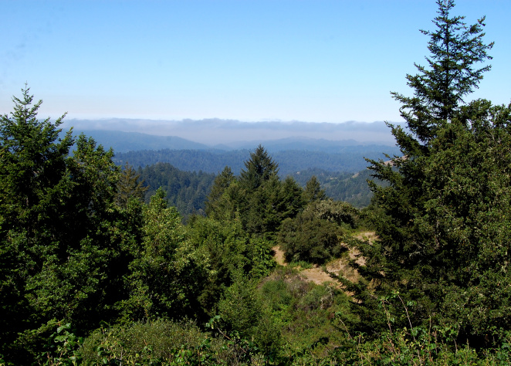
The Trail Project
Created By:
Jacob Lusk
Connor Sanders
Elizaveta Avdanina
Bhavana Mahendraker

Slide 2
Overview
A database of trails.
Pre-existing trails in database feature Californian trails good for a variety of outdoor activities. Users can add their own trails, and then search through the database for the qualities they’re looking for.

Slide 3
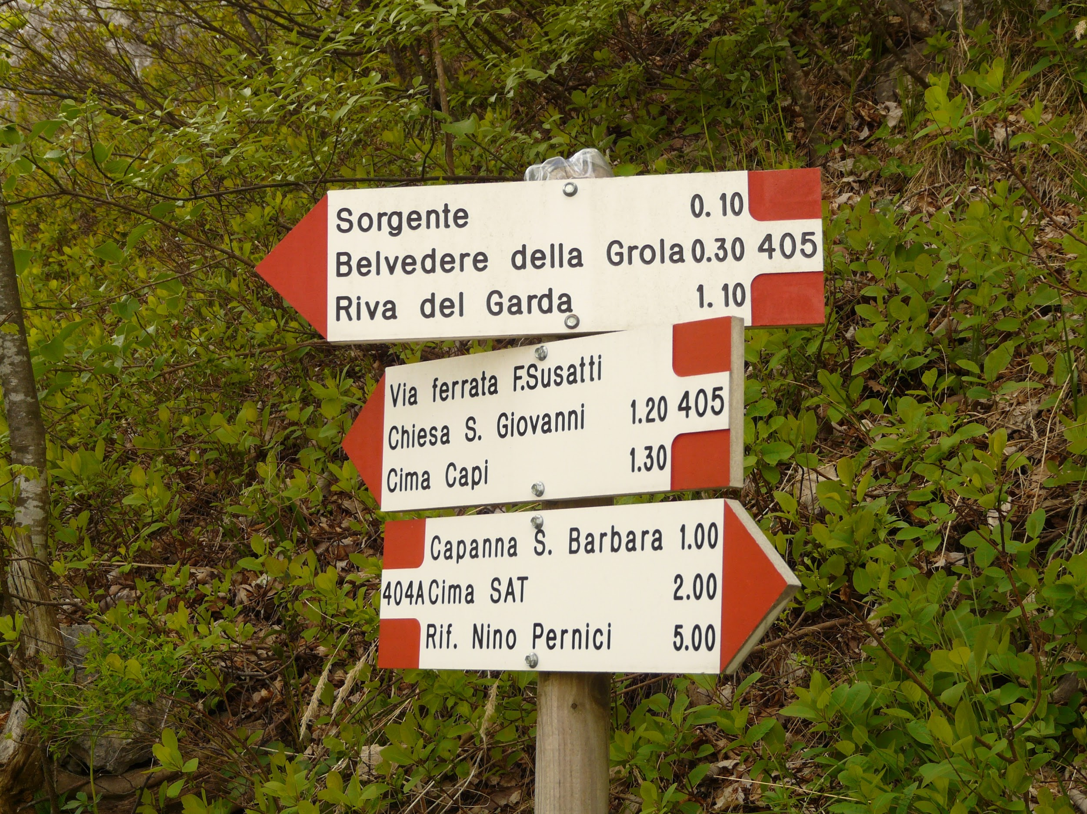
Program Features
Add
Remove
Search
By trail name
By area name
By trail length
Print
Indented Tree
Hash Table
Auto Save on add or remove

Slide 4
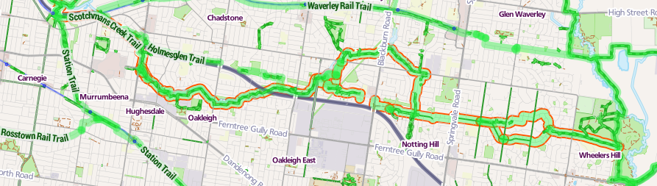
Trail Data
Difficulty
Featured Activities
Available Views
Suitability for dogs, kids, and handicapped
Route Type
Trail Traffic
Geographic Location (longitude and latitude)
Name of : Trail, Park, Country, City, State
Rating
Length (in miles)
Elevation Gain

Slide 5
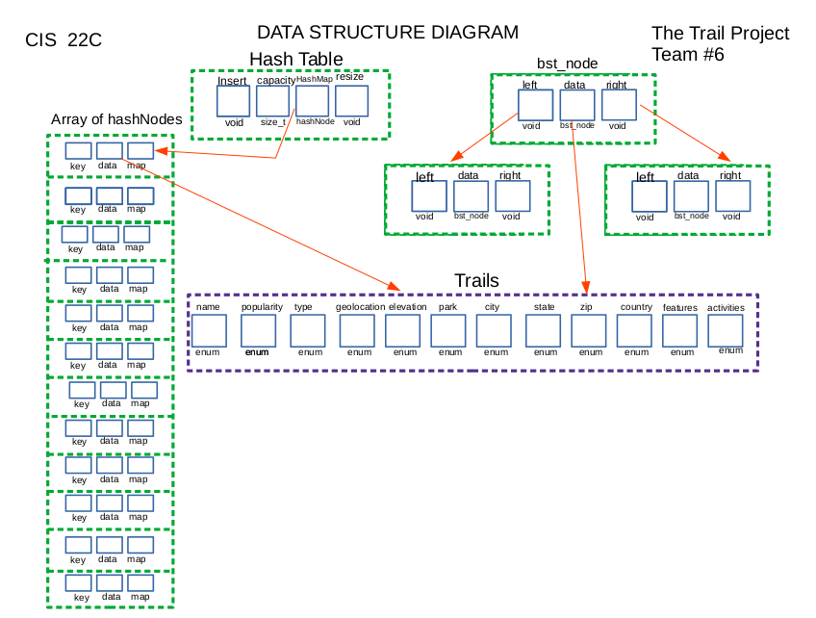
DATA STRUCTURE DIAGRAM

Slide 6
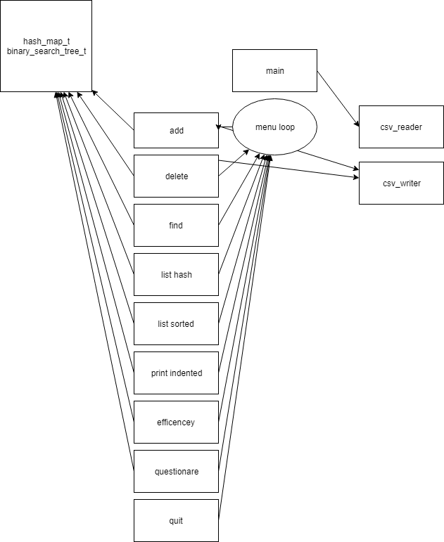
FLOWCHART

Slide 7
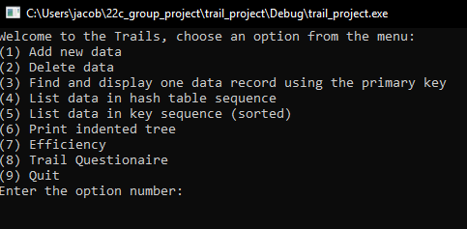
UI
Primary key is the name of the trail.
Sorted key is a function comparing trail length.

Slide 8
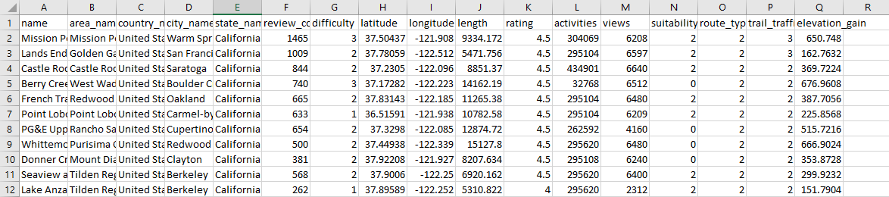
IO
A comma-separated values file (CSV file) is used to add, delete and search the data.

Slide 9
ADD
2. Delete (string primary_key)
binary_search_tree_t.insert()
hash_map_t.put()
Write to file
binary_search_tree_t.remove(primary_key)
hash_map_t.remove(primary_key)
Write to file

Slide 10
3. FIND
4. LIST
hash_map_t.find(string primary_key)
binary_search_tree_t.vertical_print()
hash_map_t.print()
binary_search_tree_t.inorder<void *>(print_inorder_fn, NULL);

Slide 11
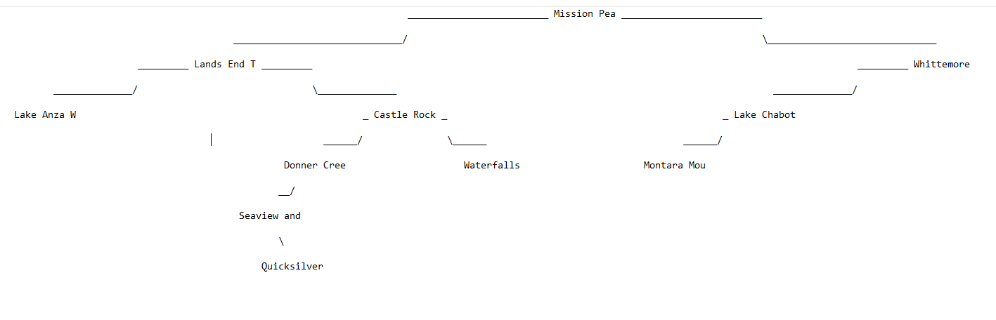
TREE (subtree)

Slide 12
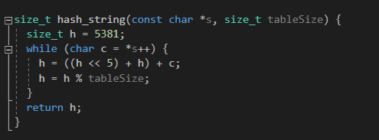
HASH MAP
Hash Function
Implemented as buckets with separate chaining with linked lists
Keys
Buckets
“Byrne Trail”
“Coyote Ridge Trail”
“Round Valley Perimeter Loop”
“Round Valley Perimeter Loop”
“Byrne Trail”
...
...

Slide 13
COLLISION RESOLUTION
We use a linked list for collision resolution, first allocating n buckets, and setting their status to empty, when a put is issued we fill the bucket, and if there is a collision we create a new bucket and set the previous bucket’s next pointer to the newly created bucket.
This allows for a potential greater than 100% load factor as we can have more than capacity items in our map, to be efficient we resize our map when we get above a load factor of 50% and set the new capacity to next_prime(old_capacity * 2)

Slide 14
Efficiency
For our hash map, we report load factor, and also every operation can be benchmarked for it’s iterations through n buckets and through each bucket’s k links noted by linked_traversal.
For our binary search tree, we make note of the size of the tree. For insert and delete we mark how many comparisons and iterations it took for a specific insert, similarly to the hashmap these can be benchmarked separately.

Slide 15

SPECIAL FEATURE

Slide 16
Trail Questionnaire!
Given our large set of data, we can filter down to a smaller subset of data based on features that we had found interesting in the data set.
One issue was the poor reporting of activities by the original data source, so instead we take advantage of the views property of our trail.
We ask a series of yes or no questions and hone down the data set to the user’s preference. This is only possible due to our large data set.
As a future endeavors, creating a complete expression parser would have been ideal.

Slide 17

DEMO

Slide 18
Things To Improve On
AVL tree instead of BST
Given the breadth of data, printing un-balanced trees takes up too much room to be visually useful or helpful.
Improve our questionnaire to allow the user to specifically insert their own queries about how they might want to sort the data.
Finding a better way to go about displaying our data, since the large data set is problematic for a tree.
Read JSON input instead of CSV

Slide 19

Q & A

